Slide 1
Network: MSFTGUEST Click [Event Attendee Code] Event Code: MSEVENT594CQ

Slide 2
Welcome! We'll start in ~10 minutes

Slide 3
Azure Databricks Workshop

Slide 4
Session Info
Wifi Connection Info: MSFTGuest
Event Code: msevent313am
Azure Databricks URL:
http://eastus2.azuredatabricks.net
Power BI Desktop Download: https://powerbi.microsoft.com/en-us/desktop/

Slide 5





ABOUT BLUEGRANITE
Microsoft partner delivering Business Intelligence, Advanced Analytics, and Data Management solutions on Microsoft’s Azure, SQL Server and Power BI platforms
your data & analytics experts
DATA
ACQUISITION ETL / ELT, Batch, Streaming
PREPARATION Enrichment, Governance, Master
PROVISIONING Data Lakes, Data Warehouses
ANALYTICS
MODELING Business Logic, Cubes
CONSUMPTION Monitoring, Reporting, Exploration
ADVANCED Data Mining, Predictive, ML
DISCOVER
REALIZE
CREATE
Explore innovative ideas to understand value and build a foundation for success beyond requirements to possibilities
Enable users and help address key pain points, realize gains, uncover insights
Extend ROI and harvest value from your investments by aligning culture
www.blue-granite.com
Phone: 877.817.0736 | e-mail: sales@blue-granite.com

Slide 6

Quick Workshop Overview
Azure Databricks Intro
Azure Databricks Demo
Labs Walkthrough

Slide 7



Concerns about AI and Big Data Projects
Tools
Wow, there’s a lot of tools out there. Which one do I need? Do I need more than one?

Slide 8

Concerns about AI and Big Data Projects
Skills
Tools
Do I currently have these skills in my organization?

Slide 9

Concerns about AI and Big Data Projects
Skills
Cost
Tools
How much will this new solution, all its infrastructure, and the hires and training cost?

Slide 10

Concerns about AI and Big Data Projects
Skills
Cost
Tools
Time
How long will it take me to get to production and realize any value from the solution?

Slide 11
Recent CIO/IDG Research Services Survey
What’s happening in AI Projects?
90% Investing Heavily in AI
1 in 3 Projects Make it to Production
Projects average more than 6 months to make it to production

Slide 12
Recent CIO/IDG Research Services Survey
What is contributing to AI project hardships?
Data-related challenges are slowing 96% of organizations
56% claim data prep and aggregation of Big Data is Very/Extremely Challenging.
56% claim data exploration and iterative model development with Big Data is Very/Extremely Challenging.
53% claim deploying models to production quickly and reliably is Very/Extremely Challenging.
80% experience reduced productivity due to siloed data science and engineering
Average of 7 different tools

Slide 13
What is Azure Databricks?
Unified data platform in Azure providing fast, secure, collaborative analytics using Apache Spark.

Slide 14








What Use-Cases is Azure Databricks Good For?
Interactive Analytics
Batch ETL Processing
Machine Learning
Streaming Event Processing

Slide 15






Who Uses Azure Databricks
Data Engineer
Data Scientist
Business Analyst
Transform data and create and schedule batch and streaming ETL jobs
Explore data, create and deploy machine learning models, and perform other advanced analytics tasks
Write SQL queries and analyze and visualize data in Databricks notebooks or tools like Power BI and Tableau

Slide 16

Works with Popular Programming and Query Languages
SQL
Write ETL, train machine learning models, and write ad-hoc queries for data analysis using popular and familiar languages.
Python
R
Scala

Slide 17









Works with Popular Data Science and Deep Learning Frameworks
=
Machine Learning
Azure ML
Amazon ML

Slide 18
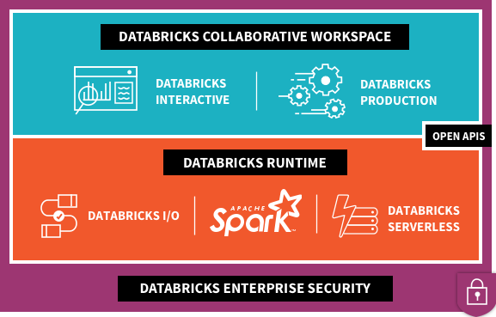


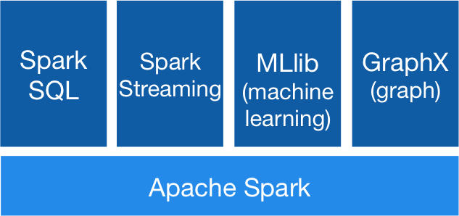









What’s Under the Hood?
2
1
Data Factory
Power BI
3
Data Lake
Store
Blob
Storage
SQL Data
Warehouse
SQL DB
Cosmos DB
Event Hubs
Kafka
On HDInsight

Slide 19
What’s Under the Hood?
Data Factory
Power BI
Data Lake
Store
Blob
Storage
SQL Data
Warehouse
SQL DB
Cosmos DB
Event Hubs
Kafka
On HDInsight

Slide 20
What’s Under the Hood?
2
1
Data Factory
Power BI
3
Data Lake
Store
Blob
Storage
SQL Data
Warehouse
SQL DB
Cosmos DB
Event Hubs
Kafka
On HDInsight

Slide 21
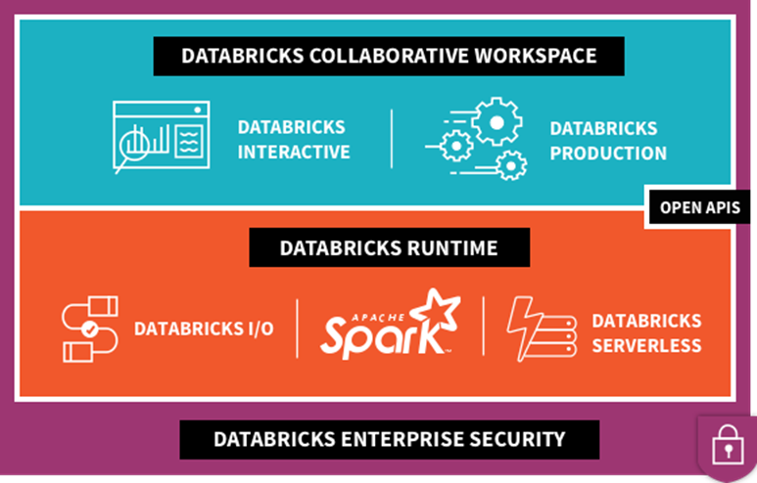
What’s Under the Hood?
2
Data Factory
3
1
Power BI
4
Data Lake
Store
Blob
Storage
SQL Data
Warehouse
SQL DB
Cosmos DB
Event Hubs
Kafka
On HDInsight

Slide 22
What’s Under the Hood?
2
1
Data Factory
Power BI
3
Data Lake
Store
Blob
Storage
SQL Data
Warehouse
SQL DB
Cosmos DB
Event Hubs
Kafka
On HDInsight

Slide 23
What’s Under the Hood?
Supported Azure Storage
Connectivity to Other Services
2
Kafka
On HDInsight
Data Factory
Data Lake
Store
Blob
Storage
SQL Data
Warehouse
SQL DB
Cosmos DB
Event Hubs
Power BI
Power BI
Data Factory
Data Lake
Store
Blob
Storage
SQL Data
Warehouse
SQL DB
Cosmos DB
Event Hubs
Kafka
On HDInsight

Slide 24







Where Does Azure Databricks Fit in the Azure Data and AI Platform?
Data Factory
Data Lake Store
Cognitive
Services
Machine Learning
Services
Power BI
Event Hubs
Blob Storage
Data Lake
Analytics
Stream
Analytics
HDInsight
Logic Apps
SQL Data Warehouse
Apps
HDInsight w/Kafka
Cosmos DB
Ingest
Store
Train and Prepare
Serve and Publish

Slide 25





Modern Data Platform with Azure Databricks
Ingest
Store
Prep and train
Serve
Model Serving
Azure Machine Learning service
Azure Kubernetes service
Azure Event Hubs
Streaming data
Operational Databases
Apps
Cosmos DB, SQL DB
Azure Databricks
Ad-hoc Analysis
Power BI
Batch data
Azure analysis services
Azure Data Factory
Azure Data Lake Storage
Azure SQL data warehouse

Slide 26
Modern Big Data Warehouse
Ingest
Store
Prep & Train
Model & Serve
Intelligence
Logs, files and media (unstructured)
Data factory
Azure storage
Azure Databricks
(Spark)
Business / custom apps
(Structured)
Polybase
Data factory
Azure SQL Data Warehouse
Analytical dashboards

Slide 27
Advanced Analytics on Big Data
Ingest
Store
Prep & Train
Model & Serve
Intelligence
Logs, files and media (unstructured)
Data factory
Azure storage
Azure Databricks
(Spark Mllib, SparkR, SparklyR)
Azure Cosmos DB
Web & mobile apps
Business / custom apps
(Structured)
Polybase
Data factory
Azure SQL Data Warehouse
Analytical dashboards

Slide 28
Real-time analytics on Big Data
Ingest
Store
Prep & Train
Model & Serve
Intelligence
Unstructured data
Azure HDInsight (Kafka)
Azure Databricks
(Spark)
Polybase
Azure storage
Azure SQL Data Warehouse
Analytical dashboards

Slide 29
Workshop Starts at 12:30-ish

Slide 30
https://eastus2.azuredatabricks.net

